Slide 1
ELECTRIC GENERATOR
Florida Cishesa, Ife Alao

Slide 2
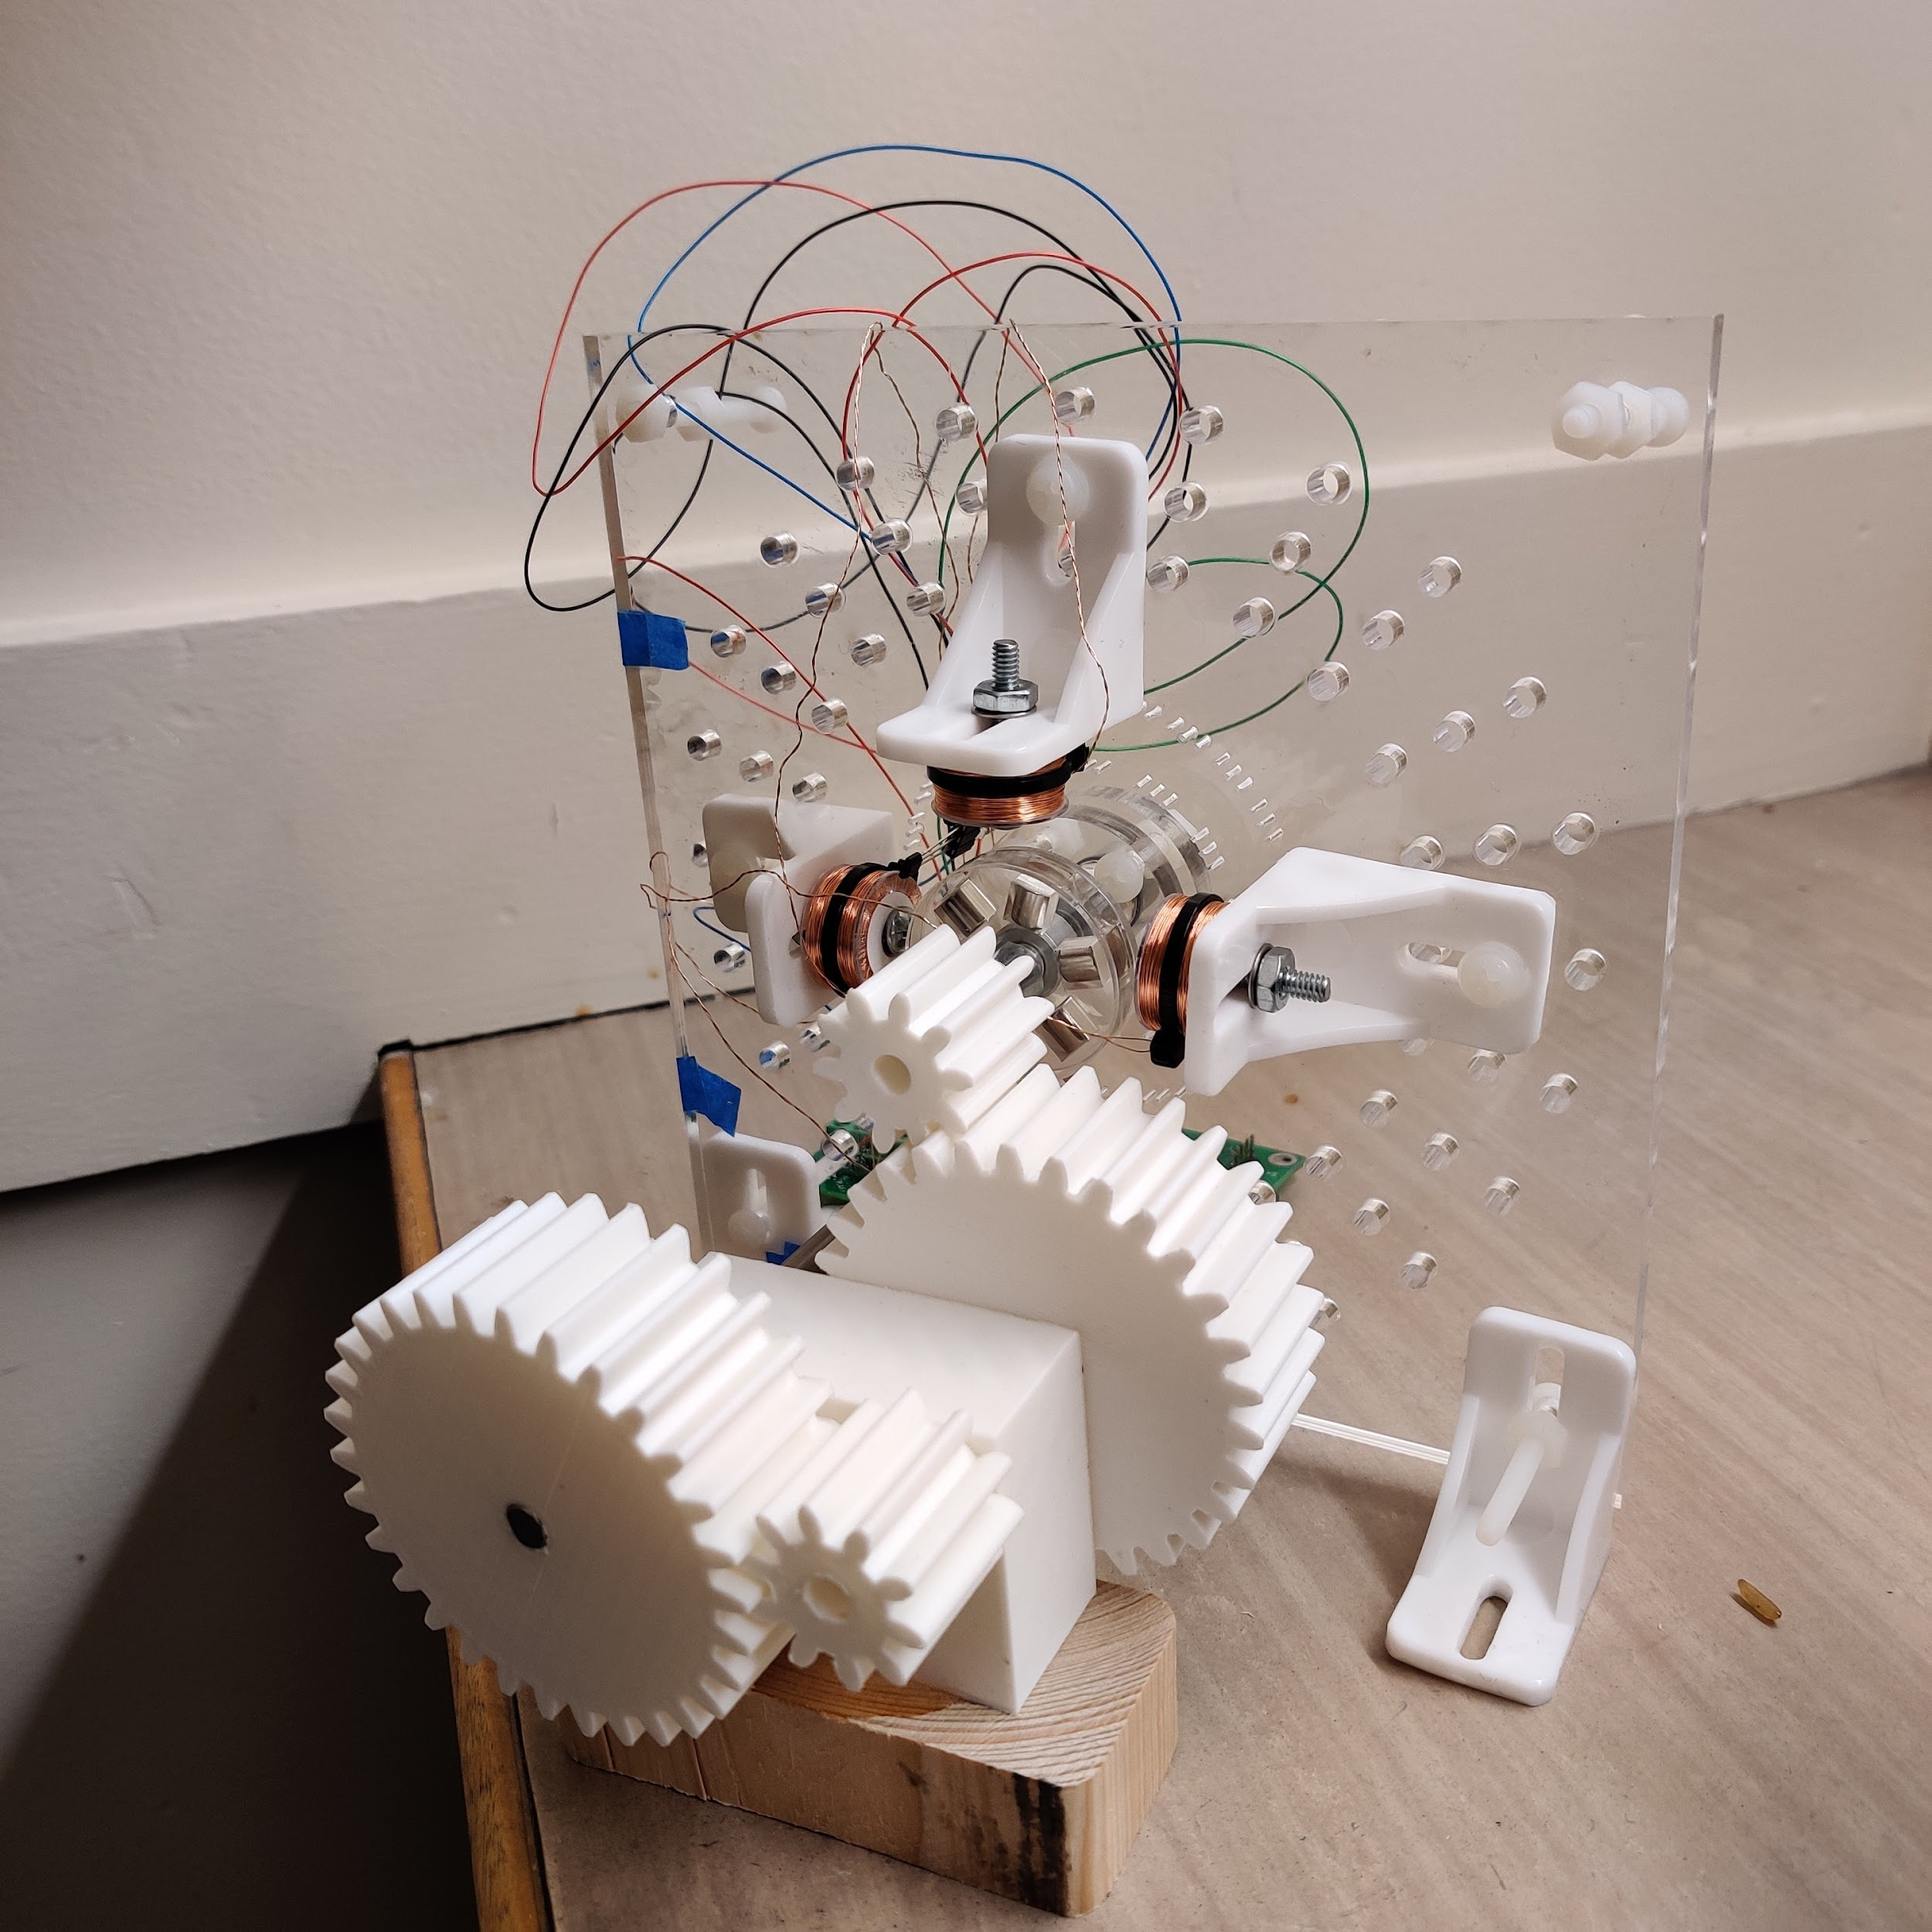
Torque Mechanism
3 D printed gears
Large contact area to minimize force input

Slide 3
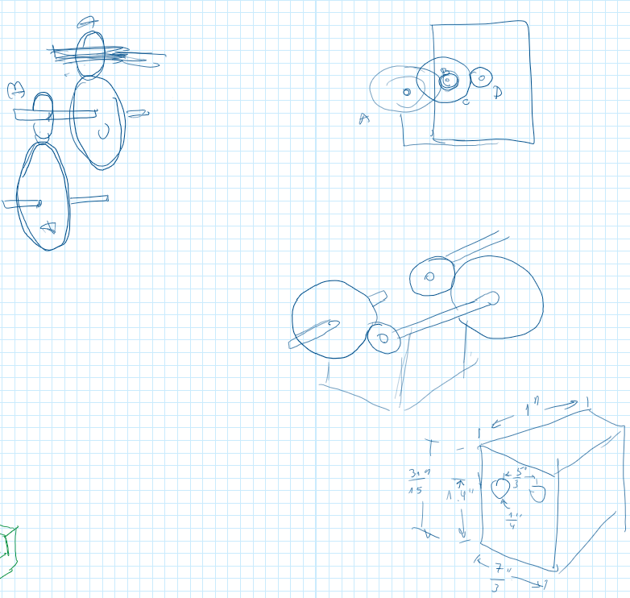
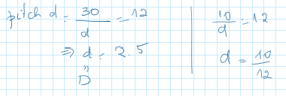
Gear Ratio and Support
Pitch diameter: 12
D= 2.5 in
d= 0.833 in
Ratio: 1:30

